Slide 1
Data Cube: A Relational Aggregation Operator Generalizing Group-By, Cross-Tab, and Sub-Totals

Slide 2
Topics to be Covered
What is data cube?
Steps of Data Analysis
Data Analysis Tool
Aggregation
Aggregate Functions
How do traditional relational databases fit into this multi-dimensional data analysis picture?
Extensions in some SQL systems

Slide 3
What is Data Cube?
data cube refers is a three-dimensional or higher range of values
It can be viewed as a collection of identical 2-D tables stacked upon one another.
Data cubes are used to represent data that is too complex to be described by a table of columns and rows

Slide 4
Steps of Data Analysis
formulating a query that extracts relevant data from a large database
extracting the aggregated data from the database into a file or table
visualizing the results in a graphical way
analyzing the results and formulating a new query

Slide 5
Data Analysis Tool
represent the dataset as an N-dimensional space.
Excel is a widely used Data Analysis Tool
Uses
dimensionality reduction (aggregation) for better understandability.
constructs such as histogram, cross-tabulation, subtotals, roll-up and drill-down.

Slide 6
Aggregation
Data aggregation is any process in which information is gathered and expressed in a summary form, for purposes such as statistical analysis.
A common aggregation purpose is to get more information about particular groups based on specific variables
Data Analysis tools support aggregation in the form of histogram, cross-tabulation, subtotals
The SQL Standard supports aggregation using aggregate functions and the GROUP BY operator.

Slide 7
Aggregate Functions
The SQL standard provides five functions to aggregate the values in a table:
COUNT()
SUM()
MIN()
MAX()
AVG()

Slide 8
How do traditional relational databases fit into this multi-dimensional data analysis picture?
Relational systems model N-dimensional data as a relation with N-attribute domains

Slide 9
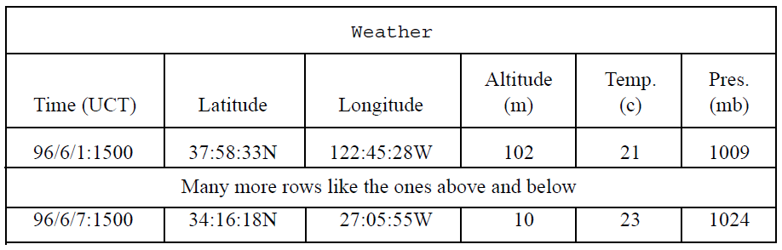
Weather Table

Slide 10
Extensions in some SQL systems
many SQL systems add statistical functions
median, standard deviation, variance physical functions
Some systems allow users to add new aggregation functions.
Init(&handle): Allocates the handle and initializes the aggregate computation.
Iter(&handle, value): Aggregates the next value into the current aggregate.
value = Final(&handle): Computes and returns the resulting aggregate by using data saved in the handle. This invocation deallocates the handle.

Slide 11
Roll-up
enables a SELECT statement to calculate multiple levels of subtotals across a specified group of dimensions
generates a result set that shows aggregates for a hierarchy of values in the selected columns.

Slide 12
How Roll-up works
ROLLUP(A, B, C)
(A, B, C)
(A, B)
(A)
()
ROLLUP((A, B), C)
(A, B, C)
(A, B)
()

Slide 13
Example of Roll-up
Item | Color | Quantity
Table | Blue | 124
Table | Red | 223
Chair | Blue | 101
Chair | Red | 210

Slide 14
Example of Roll-up (continued)
Item | Color | Quantity Sum
Table | Blue | 124.00
Table | Red | 223.00
Table | ALL | 347.00
Chair | Blue | 101.00
Chair | ALL | 311.00
Chair | Red | 210.00
ALL | ALL | 658.00

Slide 15
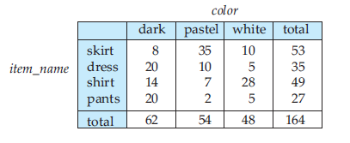
Cross tabulation
a table derived from a relation (say R), where values for one attribute of relation R (say A) form the row headers and values for another attribute of relation R (say B) form the column header
helps to understand how two different variables are related to each other

Slide 16
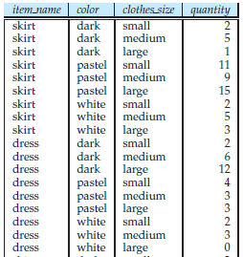
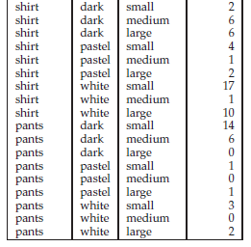
Sales Table

Slide 17
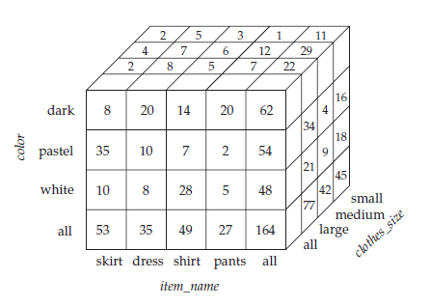
Data Cube
enables a SELECT statement to calculate subtotals for all possible combinations of a group of dimensions
Notes:
CUBE enables a SELECT statement to calculate subtotals for all possible combinations of a group of dimensions

Slide 18
Problems with GROUP BY
The standard SQL GROUP BY operator does not allow a direct construction of histograms
histograms are computed indirectly from a table-valued expression which is then aggregated.
The resulting representation of aggregation is too complex to analyze for optimization

